Slide 1
Presentation ON
Find The approximate Death using Backward Interpolation Formula

Slide 2
Presented to Ayesha Siddika Assistant Professor & Coordinator (Day) Department of CSE
Presented by Mehedi Hasan - 163432507
Md Tarikul Islam -163432568

Slide 3
Welcome to Our Presentation

Slide 4
Introduction
Road accidents have become common affairs nowadays in our country. It occurs frequently in any part of our country. Everyday we find the news of road accidents in the newspaper. Road accidents cause a great loss to the people.
Several reasons are working behind these road accidents. The drivers of the vehicles often do not care the traffic rules. They drive according to their own will. The drivers also try to overtake other vehicles. As a result, accidents occur. Sometimes, unfit vehicles are taken to the roads. These unfit vehicles cause road accidents. The roads and highways of our country are not wide enough. Most of them are narrow. This is another reason for causing road-accidents.

Slide 5
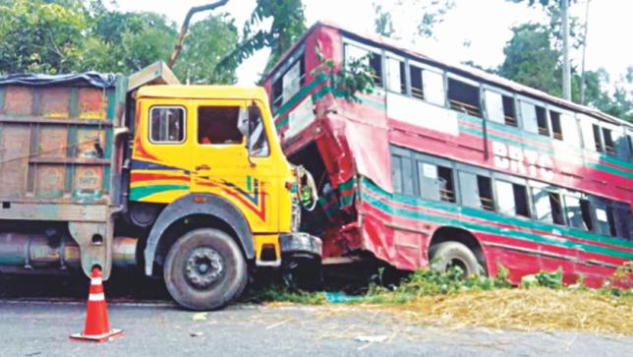

Slide 6



Slide 7
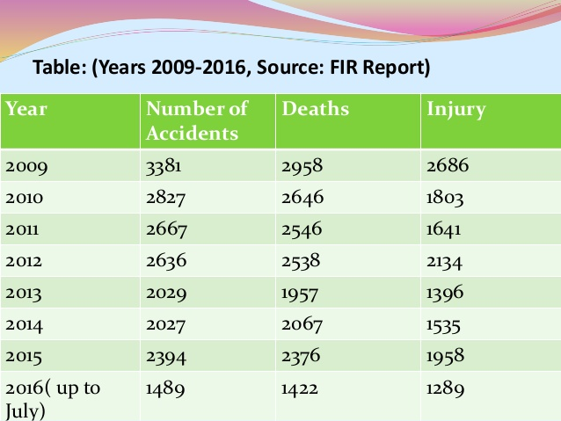
Here we represent a data table of road accident in Bangladesh, we collect it from FIR report 2016 Traffic road accident in Bangladesh

Slide 8
Let we need to find the data of 2014. If we want to find the approximate data of death in 2014 by the help of those given data, We can easily find it by applying a numerical method called Backward Interpolation Formula. It is the better solution to find the approximation form those value.

Slide 9

Backward Interpolation Formula
$$f\left(x\right)=y_{n}+u∇y_{n}+\frac{u(u+1)}{2!}∇^{2}y_{n}+\frac{u\left(u+1\right)(u+2)}{3!}∇^{3}y_{n}+…+ \frac{u\left(u+1\right)\left(u+2\right)….\left(u+\left(n−1\right)\right)}{n!}∇^{n}y_{n}$$
Where,$u=\frac{x−x_{0}}{h}$

Slide 10
Find the number of death people by road accident in year of 2014 from given table, using backward interpolation formula.
Calculate the value of f(2014) for the table:-
x | 2009 | 2011 | 2013 | 2015
y | 2958 | 2546 | 1957 | 2376

Slide 11
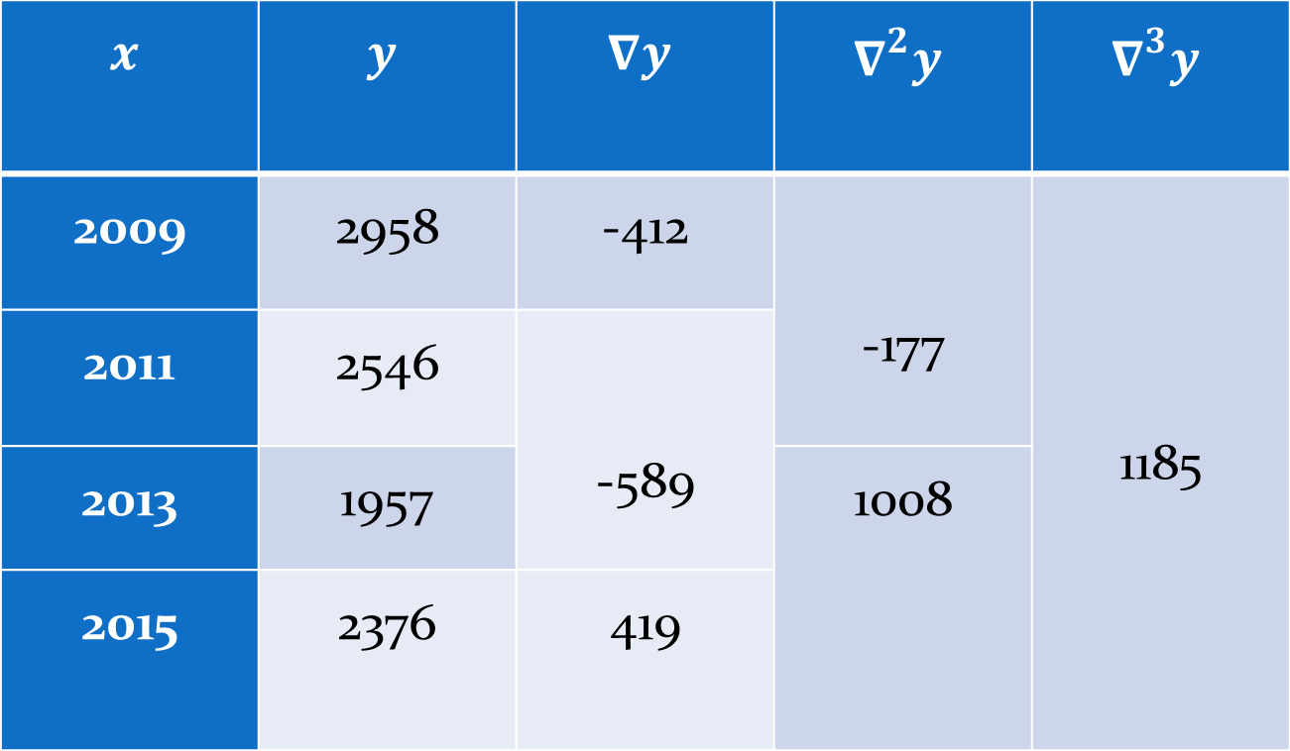
Solution:-
Difference Table:-
$$x$$ | $$y$$ | $$∇y$$ | $$∇^{2}y$$ | $$∇^{3}y$$
2009 | 2958 | -412 | -177 | 1185
2011 | 2546 | -589
2013 | 1957 |  | 1008
2015 | 2376 | 419

Slide 12

Now we have,
$$x_{n}=2015,$$
$$x=2014 and h=2$$
$$y_{n}=2376$$
$$∇y_{n}=419$$
$$∇^{2}y_{n}=1008$$
$$∇^{3}y_{n}=1185$$
Now,
$$u=\frac{x−x_{n}}{h}$$
$$=\frac{2014−2015}{2} =−0.5$$

Slide 13

Now, we know from newton backward formula
$$f\left(x\right)=y_{n}+u∇y_{n}+\frac{u\left(u+1\right)}{2!}∇^{2}y_{n}+\frac{u\left(u+1\right)\left(u+2\right)}{3!}∇^{3}y_{n}$$
$$=2376+\left(−0.5\right)∗419+\frac{\left(−0.5\right)\left(−0.5+1\right)}{2!}∗1008+\frac{\left(−0.5\right)\left(−0.5+1\right)\left(−0.5+2\right)}{3!}∗1185$$
$$=1966.4$$
$$=1966 \left(aprx\right)$$

Slide 14

Error Calculation
Error Calculation
$$We know the formula to calculate$$
$$backward interpolation error$$
$$\frac{ u\left(u−1\right)\left(u−2\right)…\left(u−n\right)}{\left(n+1\right)!}∇^{n+1}y_{n}$$
Let’s take, $n=2$
$$=\frac{u\left(u−1\right)\left(u−2\right)}{\left(2+1\right)!}∇^{n+1}y_{n}$$
$$=\frac{\left(−0.5\right)\left(−0.5−1\right)\left(−0.5−2\right)}{3!}∇^{3}y_{n}$$
$$=\frac{\left(−0.5\right)\left(−1.5\right)\left(−2.5\right)}{3!}∗1185$$
$$=−370.31$$

Slide 15
Error Calculation
So, according to Newton’s Backward Formula the approximate value of death in 2014 is 1966.
Answer: 1966

Slide 16
Conclusion
Newton’s backward interpolation formula is valid for estimating the value of the dependent variable under the following two conditions:
Values of the argument are at equal interval
(ii) The value of x corresponding to which the value of y is to be interpolated is in the last half of the series

Slide 17
THANK YOU

